Slide 1

FINAL PROJECT PRESENTATION
ITAMS
ITAMS
IT Asset Management System
Trace every asset from intake to retirement.
Jalen Bryant
SDD-680 · Software Maintenance and Testing
Professor: Teresa Peoples
June 25, 2026
Production-ready web application
with aligned documentation, testing, and handoff evidence
Production application: https://itams.app/
1
Notes:
Good day, my name is Jalen Bryant, and this is my final presentation for my Masters in Software Development capstone. My capstone project is ITAMS, the IT Asset Management System. ITAMS is a production-hosted web application that keeps organizational assets traceable from intake through assignment, active use, and retirement. In this presentation, I will connect the original business problem to the completed solution, review the final architecture and functionality, demonstrate the live application, and summarize the documentation and testing evidence that supports Milestone 5 completion. The production application is available at itams.app.

Slide 2
PRESENTATION ROADMAP
From business need to
production evidence
01
Problem and completed solution
02
Architecture and functionality
A focused walkthrough of the completed system, final validation results, and Milestone 5 submission evidence.
03
Security and live demonstration
04
Traceability and test evidence
05
Deployment, risks, and conclusion
ITAMS | Milestone 5
2
Notes:
This presentation follows the project from problem to proof. I will start with the asset-tracking problem and the completed ITAMS solution. Then I will review the technical architecture and the functionality included in the final release. From there, I will cover the security controls and move into a live demonstration of the production site. After the demo, I will explain how the requirements trace to the design, source modules, and test evidence. I will finish with the final validation results, deployment process, maintenance risks, and the Milestone 5 submission package.

Slide 3
PROJECT PURPOSE
From fragmented tracking to controlled asset management
BEFORE ITAMS
WITH ITAMS
Asset records were spread across spreadsheets and informal notes.
• Current custody was difficult to confirm
• Role responsibilities were inconsistent
• Audit and lifecycle history was incomplete
• Reporting depended on manual reconciliation
ITAMS now connects inventory, assignments, users, reports, and history in one secure browser-based system.
• Central MongoDB records with reference integrity
• Role-aware UI backed by API authorization
• Audit logs and lifecycle event history
• Production reporting and support runbooks
Result: traceable assets, controlled access, measurable evidence, and a production-ready handoff.
ITAMS | Milestone 5
3
Notes:
The problem ITAMS was built to solve is common in IT operations: asset data can become scattered across spreadsheets, informal notes, and disconnected records. When that happens, teams may not be able to quickly verify who has an asset, whether the asset record is accurate, or what changes occurred over time. Role boundaries can also become inconsistent, and reports often require manual reconciliation before they are useful. ITAMS replaces that process with a single authenticated application for inventory, assignments, users, reports, audit logs, and lifecycle history. The final solution is more than basic asset CRUD. It includes role-based authorization, MongoDB reference integrity, operational history, automated testing, production deployment, and support documentation.

Slide 4
TECHNICAL DESIGN
Layered architecture from browser to database
CLIENT
TRANSPORT
SERVER
PERSISTENCE
Blazor WebAssembly
HTTPS JSON API
ASP.NET Core API
MongoDB
Routeable pages, validated forms, role-aware navigation, API clients, and browser session storage.
Bearer access tokens identify users; refresh sessions support renewal, rotation, and revocation.
Seven endpoint groups, 26 mapped routes, authorization policies, validation, and domain services.
Document collections for assets, assignments, users, sessions, audit logs, and lifecycle events.
Production path: Git push → deployment validation → versioned IIS release → smoke checks → rollback-ready operations
ITAMS | Milestone 5
4
Notes:
ITAMS uses a layered web architecture. The client is a Blazor WebAssembly application that provides routeable pages, forms, role-aware navigation, API clients, and browser session storage. The browser communicates with the server over an HTTPS JSON API. Access tokens identify the authenticated user, and refresh sessions support renewal, rotation, and revocation. The server is an ASP.NET Core API organized into seven endpoint groups with twenty-six mapped routes, authorization policies, request validation, and domain services. MongoDB stores assets, assignments, users, sessions, audit logs, and lifecycle events as documents. In production, releases follow a Git-based deployment path that validates the build, publishes versioned output, switches IIS to the new release, and completes smoke checks so rollback remains available.

Slide 5
IMPLEMENTED SCOPE
Final functionality in the production release
Inventory
People & access
Evidence
Assets
• Create, update, and delete records
• Filter and paginate inventory
• Track status, type, dates, department, and assignment state
Assignments
• Open and close custody records
• Synchronize each asset’s current assignee
Users
• Admin-managed accounts
• Roles, departments, and active status
• Password reset and account controls
Authentication
• Login, refresh, and logout
• Change password
• Bootstrap administrator setup
Reports
• KPI overview
• Asset, user, assignment, warranty, and lifecycle trends
History
• Read-only audit logs
• Lifecycle events and field changes
• Actor, time, entity, and result context
ITAMS | Milestone 5
5
Notes:
The final release can be described in three areas: inventory, people and access, and operational evidence. Inventory includes asset creation, updates, deletion, filtering, pagination, status tracking, and assignment-state tracking. The assignment workflow opens and closes custody records while synchronizing the asset’s current assignee. People and access includes administrator-managed accounts, roles, departments, active status, password resets, login, refresh, logout, password changes, and bootstrap administrator setup. The evidence area includes KPI reporting, asset and user breakdowns, assignment and warranty trends, read-only audit logs, and lifecycle history. These features are connected to the production API and MongoDB data model, which supports a complete workflow from asset intake through operational reporting.

Slide 6
NON-FUNCTIONAL REQUIREMENTS
Security is enforced beyond the visible interface
IDENTITY & SESSION
AUTHORIZATION & HARDENING
JWT access tokens
Server-side refresh sessions
Refresh-token rotation
Password hashing
Account lockout
Session revocation after sensitive changes
Role policies for Admin, Manager, Technician, Auditor, and User
Auditor read-only controls
Rate limiting and request-size limits
CORS and security headers
Generic login failure responses
Server-side validation on protected routes
The UI can hide an action, but the API policy is what blocks unauthorized access.
ITAMS | Milestone 5
6
Notes:
Security is enforced at both the client and API layers. The client improves usability by hiding actions that do not apply to the current role, but the API authorization policy is the control that actually blocks unauthorized behavior. JWT access tokens are backed by server-side refresh sessions, which means access can be revoked after logout, password changes, administrative password resets, role changes, status changes, or account deactivation. Additional protections include password hashing, account lockout, refresh-token rotation, rate limiting, request-size limits, CORS controls, security headers, generic login failure responses, and server-side validation on protected routes. Auditor accounts are intentionally limited to read-only reporting and history access.

Slide 7
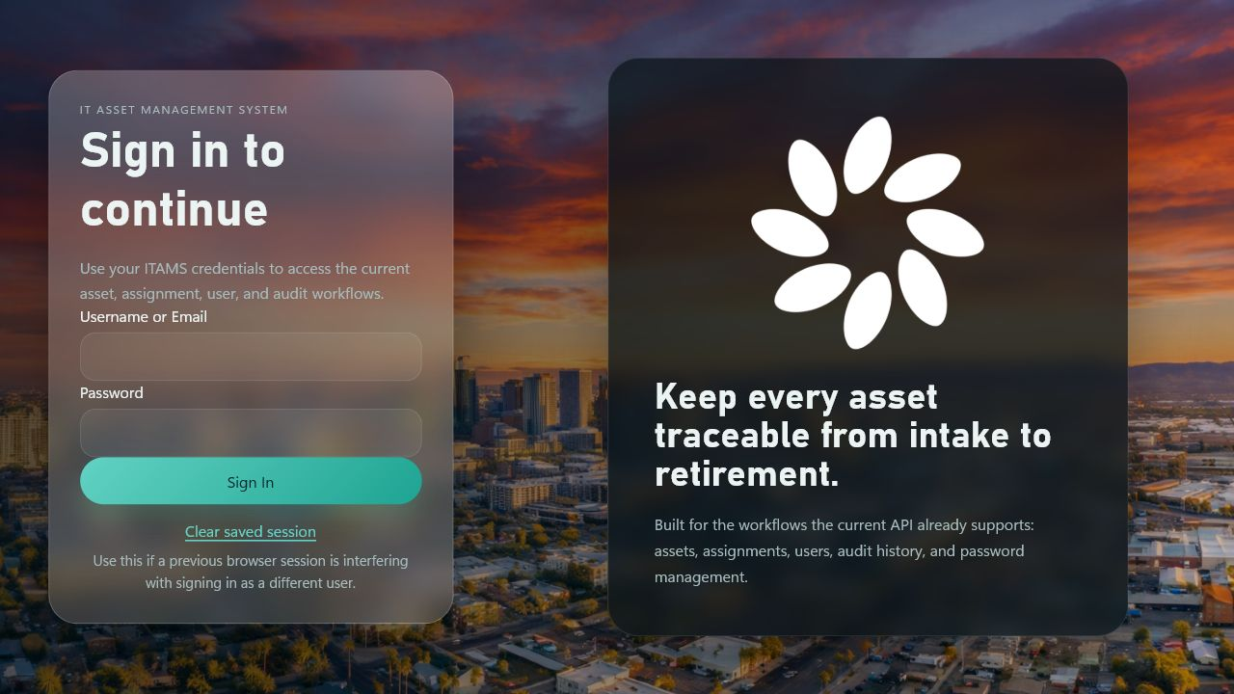
LIVE DEMONSTRATION
Demonstrating the finished production workflow
LIVE APPLICATION
Production workflow walkthrough
1 Sign in and confirm role-aware navigation
2 Create or update an asset record
3 Open and close an assignment
4 Review user administration and authorization behavior
5 Show reports, audit logs, and lifecycle history
A complete workflow from secure sign-in
to operational evidence and sign-out.
6 Sign out and confirm session revocation
https://itams.app/
7
Notes:
I will now demonstrate the production application at itams.app. I am starting at the secure sign-in page. After I sign in, the system loads navigation and available actions based on the current user’s role.
First, I will open the Assets page. This page shows inventory records with filtering and pagination. I can review details such as asset tag, serial number, type, manufacturer, model, status, department, location, lifecycle dates, and current assignment. I can also create or update an asset, and the API validates the record before it is saved.
Next, I will open the Assignments page. This workflow connects an existing asset to an existing user, records the start date and notes, and supports closing custody records. When an assignment changes, ITAMS synchronizes the asset’s current assignment state and records the related history.
The Users page demonstrates administrative account management. Authorized users can maintain roles, departments, active status, and password reset controls. These actions are not protected only by the interface; they are also enforced by server-side authorization policies.
The Reports page summarizes operational data with KPIs, breakdowns, and trends. The History page provides read-only audit logs and lifecycle events with the actor, time, affected entity, action, and recorded change context. These records provide accountability for important activity.
To close the workflow, I will sign out. The active session is revoked, and the application returns to the sign-in page.

Slide 8
DOCUMENTATION ALIGNMENT
Requirements, design, code, and tests align
REQUIRE
DESIGN
BUILD
VERIFY
10 user stories
8 NFRs
Architecture
and controls
Pages, endpoints,
and services
Test cases and
27 automated tests
Example
US-003 Change password → authentication/session design → AuthEndpoints/AuthService → TC-003 + AuthenticationIntegrationTests
ITAMS | Milestone 5
8
Notes:
The final documentation creates a traceable path from requirement to proof. The Requirements Specification and User Stories define ten functional user stories and eight non-functional requirements. The Technical Design Specification explains the architecture and the controls used to satisfy those requirements. The source implementation contains the pages, endpoint groups, and services that deliver the functionality. The Traceability Matrix connects those requirements to manual and automated test evidence. For example, user story US-003 requires users to change their password. That story traces to the authentication and session design, the AuthEndpoints and AuthService implementation, test case TC-003, and the authentication integration tests. This alignment shows that the final system is supported by design, code, and verification evidence.

Slide 9
TESTING
Final validation results
27/27
17/17
4/4
7
Automated tests
Documented cases
Smoke checks
Test classes
Zero failures in the final Release configuration run.
Manual, automated, deployment, rollback, and handoff cases all marked Pass.
Site response, API authorization, API base URL, and canonical redirect verified.
Authentication, authorization/history, reports, CORS, bootstrap, context, and hardening.
Final test date: June 25, 2026 • Production URL: https://itams.app/
ITAMS | Milestone 5
9
Notes:
The final validation results provide measurable evidence that ITAMS is ready for review. The automated API and integration suite passed all twenty-seven tests with zero failures in the Release configuration. The suite includes seven test classes covering authentication, authorization and history, bootstrap administration, CORS, operation context, reports, and security hardening. The Test Cases workbook contains seventeen documented cases, and all seventeen are marked Pass. These cases cover application workflows, security behavior, deployment, rollback, and source handoff. Four production smoke checks also passed: the site responded successfully, the protected current-user endpoint rejected an unauthenticated request as expected, the API base address was correct, and the www address redirected to the canonical site.

Slide 10
OPERATIONS
Repeatable and reversible production deployment
01
02
03
04
Validate
Publish
Switch
Verify
Restore dependencies, build the solution, and run automated tests.
Publish the client and API into a versioned release.
Update IIS release pointers and recycle the app pool.
Run site, API, redirect, and configuration smoke checks.
Rollback: restore the previous versioned release, recycle IIS, and repeat smoke validation.
ITAMS | Milestone 5
10
Notes:
The production deployment process is designed to be repeatable and reversible. A validated Git deployment hook restores dependencies, builds the solution, and runs automated tests before publishing. The client and API are then placed into a versioned release directory. IIS release pointers are updated, the application pool is recycled, and the site is verified with smoke checks. The operations documentation also covers DNS, certificates, secrets, backups, logging, SSH access, and troubleshooting. If a release does not pass validation, the previous versioned release can be restored, IIS can be recycled, and the smoke checks can be repeated. This gives the project a practical operating model instead of a one-time deployment.

Slide 11
MAINTENANCE
Known risks are documented and actionable
CURRENT KNOWN RISK
MAINTENANCE RESPONSE
Dependency audit advisories
1 Track upstream package updates
2 Review release notes and compatibility
3 Apply fixes in a maintenance branch
4 Rerun the 27-test suite and smoke checks
5 Deploy through the versioned release process
SharpCompress 0.30.1
Moderate severity
Snappier 1.0.0
High severity
Both advisories are transitive and did not cause failures in the final 27-test run.
ITAMS | Milestone 5
11
Notes:
The final dependency audit identified two maintenance risks in the transitive dependency graph. SharpCompress version 0.30.1 has a moderate severity advisory, and Snappier version 1.0.0 has a high severity advisory. These advisories did not cause failures in the final twenty-seven-test run, but they are documented so they can be handled through normal maintenance. The planned response is to track upstream package updates, review release notes and compatibility, apply fixes in a maintenance branch, rerun the full automated test suite and production smoke checks, and deploy through the same versioned release process. This approach keeps the risk visible and actionable without treating it as an unresolved release blocker.

Slide 12
MILESTONE 5 COMPLETE
ITAMS is ready for final review
Completed evidence
LMS package
• Production application
• Nine finalized documentation artifacts
• Instructor approval recorded as granted
• Traceability aligned across requirements, design, code, and tests
• 27/27 automated tests and production smoke validation
• Formal PowerPoint presentation
• 10–15 minute screencast and URL
• Source-code delivery
• Final Documentation ZIP
Questions? • https://itams.app/
ITAMS | Milestone 5
12
Notes:
In conclusion, ITAMS is ready for final Milestone 5 review. The application is deployed in production, and the documentation artifacts have been finalized to align with the implemented system. Instructor approval is recorded as granted in the Project Proposal, Requirements Specification, and Technical Design Specification. The functional and non-functional requirements are traceable to the design, implementation, and test evidence. The final automated suite passed twenty-seven out of twenty-seven tests, and the production smoke checks were successful. The final LMS package includes this PowerPoint presentation, the ten-to-fifteen-minute screencast and URL, the source-code delivery, and the final Documentation ZIP. Thank you for reviewing my capstone project.

